Slide 1
Varying Optical Frequency Shifter
Optics Demo -- Group B
Marcus Darby - EE
Kevin Gaj - EE / Photonics
Samuel Nunez - Photonics
Caleb Stephan - Photonics

Slide 2
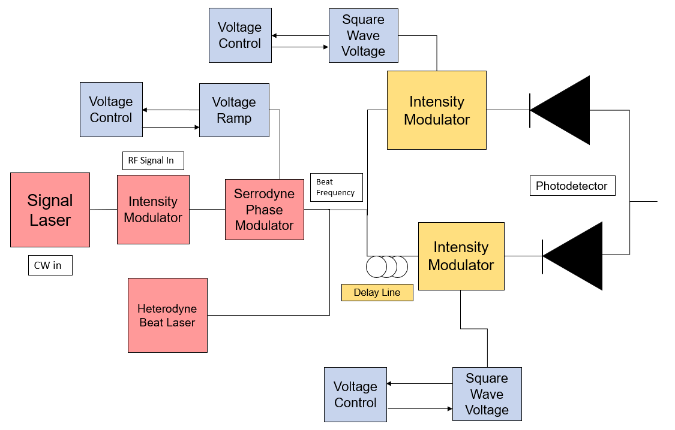
Initial Block Diagram
Red: Serrodyne components
Blue: Electronic Components
Gold: Spur Reduction Components

Slide 3
Results

Slide 4
Results (200 MHz Shift via 100 MHz Triangle)

Slide 5
Results (200 MHz Shift via 100 MHz Triangle)

Slide 6
Results (100 MHz Shift via 50 MHz Triangle)

Slide 7
Questions?

